Slide 1
CROP PRODUCTION ANALYSIS

Slide 2
INTRODUTION
The agriculture industry plays a pivotal role in ensuring global food security and economic stability. The Agriculture business domain, as a vital part of the overall supply chain, is expected to highly evolve in the upcoming years via the developments, which are taking place on the side of the Future Internet. This paper presents a novel Business-to-Business collaboration platform from the agri-food sector perspective, which aims to facilitate the collaboration of numerous stakeholders belonging to associated business domains, in an effective and flexible manner. This dataset provides a huge amount of information on crop production in India ranging from several years.

Slide 3
DETAILS OF DATA
The given dataset contain the crop production data in India. The dataset gives the information of crop production from 2003 to 2015.Crop production is more in 2003 and it decreases as years passes and crop production is least in 2015.It has 246091 rows and 7 columns. Among the 7 features Crop_year, Area and production are numerical and others are object type.
There are 3730 null values in Production variable. These null values are dropped. Thus the data has 242361 rows and 7 columns. There are no duplicated values in the data. Ouliers are presented in features like area and production.They are cleaned using winsorization method.

Slide 4
MAIN KPI’s
Crop Yield: Crop production in different regions of India.
Average Crop Yield by State: Average productivity in each state.
This KPI will help me identify regions with higher.
Crop Diversification Index: This KPI will help me understand the diversity of crops grown in India.
Seasonal Crop Production: This KPI will help me understand the seasonality of agricultural output.
Crop Production Trends: This KPI will help me identify trends in crop production over time.

Slide 5
Year Crop Production
2003 17139
2002 16536
2007 14269
2008 14230
2006 13976
2004 13858
2010 13793
2011 13791
2009 13767
2000 13553
2005 13519
2013 13475
2001 13293
2012 13184
1999 12441
1998 11262
2014 10815
1997 8899
2015 561
Highest crop production
Crop production peaked in 2003 and steadily declined, reaching its lowest point in 2015.

Slide 6
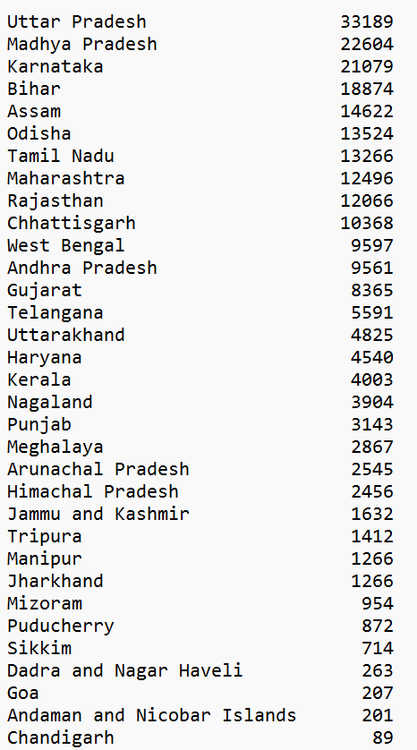
Highest crop production
Uttar Pradesh has the highest production, followed by Madhya Pradesh and Karnataka & Chandigarh has the lowest

Slide 7
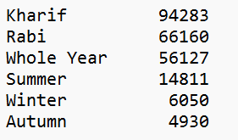
Majority of crops are grown during the "Kharif" season, with "Rabi" and "Whole Year" seasons also contributing significantly to crop production. "Summer" and "Winter" seasons have comparatively lower crop production, while "Autumn" ranks lowest.

Slide 8
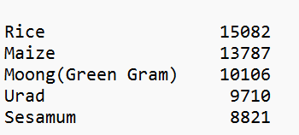
TOP 5 CROPS IN INDIA
Almost 124 types of crops are cultivated in India. Rice stands out as the most widely cultivated crop, followed by Maize and Moong.

Slide 9
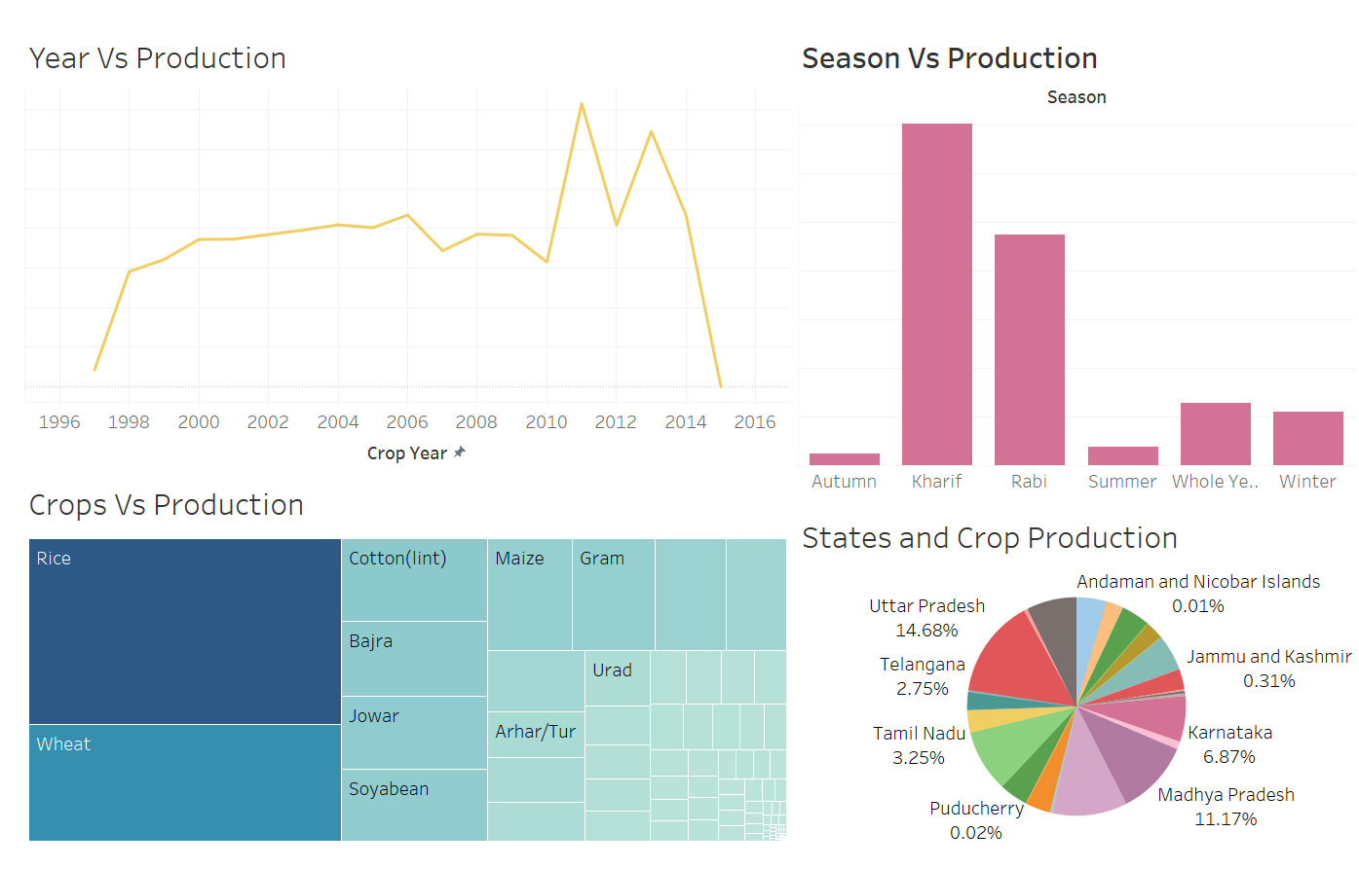
MY DASHBOARD

Slide 10
THANK YOU

